Slide 1
Oracle Apps Project Methodologies, Tool and Delivery Model

Slide 2
What to Expect from the session
After the session there will be clear understanding of below mentioned topics
Project Lifecycle
Delivery Model
Key Roles &
Responsibilities etc

Slide 3
Topics
Overall Project Approach
Managing Development
Data Migration
Testing
Post Go Live Support
Project Organization Structure
ADM Service Model
ADM Typical Delivery Organization
Tools & Accelerators

Slide 4

Overall Project Approach – Global Template & Pilot followed by clusters
Project Initiation
Solution Definition
Solution Development
Implementation
Post Implementation
Support
Overall Implementation Plan
Global Design Template Analysis & Design
Configure, Build and Unit Test
End User Training
Early Life Support
AS-IS Study
Future State Solution Map
DM Build & Unit Test
User Acceptance Test
Handover to IT / Support
Requirements Gathering
Strategy Definitions
System Test
Production Cutover
Pilot CRP
System Integration Test
Repeated Activities – each cluster
Alignment / Conference Room Pilot
Configure, Build & Unit Test
End User Training
Early Life Support
Cluster Design
DM Build & Unit Test
User Acceptance Test
Hand-over to IT / Support
System Test & Regression Test
Production Cutover
System Integration Test
Global level activity
Activity for pilot
Activity per cluster

Slide 5
Phase wise Key Activities
Project Initiation
Solution Definition
Align, Plan and Mobilize
Kick off the project and onboard the project team
Agree on project vision, objectives and scope
Agree on project acceptance criteria
Identify and Mobilize key stakeholders (Customer Project Team and representatives for Global Core design team from required countries)
Finalize the overall Implementation Plan
Discuss and finalize the Cluster approach
Finalize the Rollout strategy for the Clusters
Refine the Project Plan (current work package)
Conduct AS-IS Study and Gather requirements
Understand the current Customer processes, Business functions performed at each of countries in scope
As-Is System walkthrough to understand critical business process and Strategic Customizations
Conduct Inventory assessment of existing System documentation and test scripts
Conduct requirement session to gather requirement for new modules
Identify local requirements of each country having an impact on global design template (to the extent possible)
Analysis & Design
Mapping Customer Processes to R12 process
Perform Gap-Analysis and identify Gaps
Propose Solutions for Gaps - Workarounds and Customizations
Challenge customization & identify Standard functionality to replace customization
Design new /changes in organization structure , key elements like CoA
Future Solution
Document Future State Process Flows and Business Rules
Document Application Configuration – BR100
Finalize the technical Development Register – Customizations, Integrations and Data Migrations
Develop Strategy documents
Develop Release Management, Data Migration, Testing, Training, Production Cutover Strategies
Conference Room Pilot (CRP)
Validate the Global Design Template by conducting CRP for top 20 Business Scenarios for Pilot
Identify top 5 Biz Scenarios per Process streams to be covered in CRP per Cluster
Only Standard Oracle functionalities are covered in CRP for Pilot
Freeze the scope of the solution

Slide 6
Phase wise Key Activities
Solution Development
Implementation
Configure, Build and Test
Configure Application based on BR100 inputs
Develop Functional Specifications for Technical Components
Develop and Unit Test Technical Components
Data Migration Build & Test
Develop Functional Specifications for Data Migration
Develop Data Migration Routines and Unit Test
Run Data Migration Iteration#1 – System Test (60% of Data)
System Test
Create Test scripts for Testing - System Test
Create Regression Test Scripts – Base Pack
Create Performance Testing scenarios and Scripts
Perform System Test by Capgemini covering critical business processes for 1 Legal Entity in Pilot Country
Fix System Test Defects
System Integration Test
Support Customer in executing System Integration Testing
Fix System Integration Test Defects
Prepare for Implementation Phase
Prepare Rollout Kit, develop Training Material & finalize Training Schedule
Finalize the Cutover Plan
End User Training
Conduct Trainings – Train-the-Trainer
Performance and User Acceptance Test
Perform Performance Tests
Prepare UAT Instance – Configure
Run Data Migration Iteration#2 – UAT (90% of Data)
Fix User Acceptance Test Defects
Production Cutover
Run Data Migration Iteration#3 – Pre-Prod (100% of Data)
Production Cutover activities
Post Production Support
Production Problem Resolution
Provide resolutions to Production Problems
Handover to IT/Support Team
Handover the system and project documentation to Support Team

Slide 7
Deliverables (Capgemini & Customer) and Milestones
Phases | Deliverable | Milestone
Initiation | Updated project plan Project Acceptance Criteria and Procedures Requirements Definition Updated Clusters and Rollout Plan Project Environment Plan – Instance Planning (if required) | Project Kick-Off Requirements Sign-Off
Solution Definition | To-Be Business Process Flows/ To-Be Solution Map / Global Solution Document Gap Register and / or Technical Development Register Application Configuration (BR100) Release Strategy Data Migration Strategy & Plan Testing strategy & Plan Training Strategy & Plan Production Migration / Cutover Strategy & Plan | Solution Design Sign-Off Release and Configuration documents
Solution Development | Functional design documents Technical design documents Technical Components – Code and Installation Scripts Training Material System test plan, scripts and results System Integration test plan, scripts and results (Customer) Production Cutover plan | Technical Development Complete System Test Complete System Integration Test Completion (Customer)
Implementation | UAT Test Results (Customer) | User Acceptance Test Sign-Off (Customer) Production Go-Live
Post-Production Support | Defect fixes | End of Support

Slide 8
Managing Development
Customer
Capgemini
Core Solution Design
Solution Development
Implement
Post Production Support
With Technical Team
Define Technical Architecture
Gap-Analysis
Build Development Register
Impact Assessment of Existing Objects
Develop Functional Specifications
Review Functional Design Completeness & Open Items
1
Accept - Design
Bugs / Rework
Aligned to Coding Standards
Peer Review Technical Design & Code
Perform SIT
Prepare Technical Design
Develop & Unit Test Customizations
Prepare Installation Script / Patch
Perform Functional Unit Test
2
SIT Bug Fixing
Reviewed and Tested Customization
Review Comments / Rework
Perform Pre-UAT
Pre-UAT Bug Fixing
Perform UAT
UAT Bug Fixing
3
Production Deployment
Handover to AM
Post Prod and Warranty Support
1
Capgemini Technical Team Accept - Design
2
Capgemini Functional Team Approves - Development
3
Customer Accept - Development

Slide 9
Data Migration Quality enhanced through multiple dress rehearsals
Approach Highlights
Capgemini Scope of data migrations is limited to:
Master data
Open transactions
Custom Tables
Historical Data is not considered in scope.
Comprehensive Migration Strategy
Involve all relevant stakeholder
Data Cleansing and transformation requirements finalized in Solution Definition Phase
Use proprietary Data Migration Toolkit
Focus on Data Quality and Cutover time
Multiple Iterations of Dress Rehearsals – System Testing (60% data), UAT (90% data) and Pre- Prod (100% data)
System Testing
UAT
Pre-Prod
Global Template & Pilot Implementation
Repeated for each Cluster

Slide 10
Holistic Testing approach with Quality gates right through design and deployment phases
Test Strategy
Approach Highlights
Dedicated Test Manager for Test Management and reporting
System Testing critical scenarios of a legal entity and cover representative SBUs in Pilot
System Testing for each cluster with focus on the changed business process / solution component pertaining to a legal entity of the cluster
Customer to execute System Integration comprising testing of integration testing and User Acceptance Test
Regression Testing during each cluster rollout
Relevant Performance Testing scenarios for testing in Pilot phase
Master Test Plans
Monitoring, Reporting & Adjusting
Test Plan per Cluster
Test Plan per Cluster
Test Plan per Cluster
Test Activities
Test Activities
Test Activities
Requirements
User Acceptance Test
Other Test Activities
Conference Room Pilot: Design Validation
Performance Testing
Regression Testing
Smoke Testing
Accelerators
Functional Specs and Design
System Integration Testing
Re-usables from customer
Testing Toolkit
Design Specification
System Testing
System Build and Unit Test

Slide 11
Holistic Testing Approach – Pilot implementation
Phase | Testing | Objective | Who prepares | Who Executes | Who Supports
Solution Definition | Conference Room Pilot | Validate process design based on out-of-the-box product features | Capgemini | Capgemini | Customer (validates CRP scenarios)
Solution Development | Unit Testing | Test the developed objects based on user process steps that can be invoked by users | Capgemini | Capgemini | -
Solution Development | System Testing | Test the overall solution including custom objects by testing business flows executed in E - Business suite | Capgemini | Capgemini | Customer (validates SIT scenarios)
Solution Development | System Integration Testing | Test the integration of E - Business suite with other systems | Customer | Customer | Capgemini (defect fixing)
Implementation | User Acceptance Testing | Test the overall solution including custom objects by testing business flows executed in E - Business suite and integration with other systems | Customer | Customer | Capgemini (defect fixing)
Implementation | Performance Testing | Test the overall system performance based on critical processes involving interfaces, batch jobs and reports. | Customer | Customer | Capgemini (creates test scripts on EBS side, tunes performance of custom EBS components)

Slide 12
Holistic Testing Approach – Cluster Rollout
Phase | Testing | Objective | Who prepares | Who Executes | Who Supports
Solution Development | Unit Testing | Test the objects developed in cluster based on user process steps that can be invoked by users | Capgemini | Capgemini | -
Solution Development | System Testing | Test the solution for changed custom components by testing business flows executed in E - Business suite | Capgemini | Capgemini
Solution Development | Regression Testing | Test the solution based on identified scenarios to ensure that there is no negative impact post pilot go-live on the solution with addition of new countries during cluster rollouts. | Capgemini | Capgemini
Implementation | User Acceptance Testing | Test the solution for the changed solution components by testing business flows executed in E - Business suite and integration with other systems | Customer | Customer | Capgemini (defect fixing)

Slide 13
Post Go Live Support Approach
User Level
LEVEL 1
LEVEL 2
LEVEL 3
Infrastructure Support
Streams | Capgemini Scope (Support Window: 8 hours, 5 days a week) | Customer Scope
Service desk |  | Publish known System downtime User Creation and Rights Management Management and Reporting
Functional | Support Business Service Request including First Month end closing Analyze & solve Support Requests raised Maintain Application Setup Apply Data Fix Manage Knowledge Repository | Key Users to handle User queries before raising support request Answer “How to” questions Translate Support Request in English Liaise with Oracle Support for Product issues
Technical & Infra | Custom Code fix Custom Code Deployment assistance | Apps DBA , db Admin & Sys Admin activities Monitor batches Monitor integration Industrialization
Infra issue or request
Service Desk
Infrastructure L2 & L3 Team
.
 User
.
Functional Support
Application issue or request
Service Desk
L2 Support
Support request
L3 Support
 Key user
Custom Code fix required
Technical Support
L3 Support
.
Contributors Editors, …
Scope of the Post Production Support
Scope of the Warranty

Slide 14

Project Organization Structure
Capgemini Executive Sponsor
Customer Steering Committee
Delivery Executive
Account
IT Director
Executive
PMO
Project Manager
Project
PMO
Manager
Stream Approach
Solution Architect
Cluster
Cluster
Business Lead
Scope split into
Leads
Leads
streams to simplify
Functional
Super Users
Work
Technology
Finance
O2C
P2P
D2R
Management and
Stream
Stream
Stream
Stream
Stream Leads
have in
-
depth
Architect
Lead
Lead
Lead
Lead
&
focus at each
Development
Cluster Leads
stream
R12 Functional Team
Manager
–
Analysis, Design & Configuration, and Training
Tech
Lead
Technical
Team
–
CEMLI Uplift, Build and Unit Test
Development Team
DM Lead
Data
Migration
Team
–
Data extraction, transformation and loading
Data Migration Manager
IT Team
Test
Manager & Team
-
Test Management
Test Manager
Offshore Delivery Manager
Teaming with Customer resources
Apps DBA
To leverage Customer knowledge on business
processes and setup of current R11i environment
Project Office
Onshore
Mumbai
Project Office
Onsite & Offshore
Customer
Location
Offshore
Location

Slide 15
Roles and Responsibilities
Capgemini Roles | Capgemini Team Responsibilities | Customer Counterpart | Customer Team Responsibilities
Capgemini Executive Sponsor | Overall leadership accountability for the engagement for Capgemini & Provide Quality oversights | Project Governance | A Steering Committee with representatives from business, functional and technical IT on Director level.
Account Executive | Be the sole SPOC for customer regarding all account related issues
Delivery Executive | Sets the overall direction for all of the components of the project, holds overall responsibility to manage the scope change process, stakeholders, contracts
Project Manager | Overall responsibility for the project execution, quality, schedule and deliverables from Capgemini | Project Management | Jointly manage the project with Capgemini’s Project Manager to co-ordinate and facilitate sign offs
PMO | Assists the project manager in defining and implementing project standards of processes and procedures
Solution Architect | Overall responsible for the functional solution | Business Team and Process Excellence Team (including key users on a need basis) | Provide Capgemini an understanding of current business processes in their respective stream Work with Capgemini on various R12 activities
Functional Stream Leads (Finance, P2P, O2C, D2R) | Responsible for all functional aspects of their respective streams
Functional Team | Requirement Gathering, Solution design of the modules, Configurations, Testing, Func. & Tech. Specs.
Technical Architect | Ownership of the technology solution implementation across multiple work streams | IT Team, Data Migration Lead IT DBA Team, | Provide explanation about existing 11i customizations and Bespoke systems, ensure that Customer quality standards are followed, Provide DBA & infrastructure support
Technical Lead / Data Migration Lead | Owns the technical scope of all activities under their respective streams
Development Factory: Technical Team | Manage and document technical components based on gap and impact analysis, development & deployment of customizations, unit testing, defect fixing
Data Migration Factory: Technical Team | Design, Build and test Data migration routines covering extraction, transformation and loading, Dry Runs and Data migration reconciliations
Test Manager | Responsible for planning, monitoring and reporting of all test activities during the project | IT Team | Support for planning, monitoring and reporting of all test activities during the project
Testing Factory: Testing Team | Identifies & Executes test scenarios for System Test, Performance Testing and Regression Testing

Slide 16
Our ADM Service Model is Adjusted to Client Needs, (Baseline + On-demand Services) based on Rightshore®
Business Departments
IT Competence Centre
BEST PRACTICE
Help Desk
On Demand Service
(Change Request & Projects)
Application Management
– 2nd Level Support –
Service Management
Rightshore®
Service Level Measurement & Reporting
Service Level Agreement Management
Service Reporting
Escalation Management
Onsite
Client Knowledge
Cultural/local language fit
Multilevel relationship
Understand client’s business challenges
Offshore
Industrialised delivery (Factory) located in GDC
Basic understanding of clients systems & processes
Customising
Incident Management
Application & Integration Management
– 3rd Level Support –
Development Enhancement
Data Migration & Testing
Bug fixing
Problem Management
Project Support
Cont. improvements
Infrastructure & 3rd Party Management
Implementation of CRs and Projects (via Rate card)
Design
Implementation (Customising, Development, Testing)
Deployment (Data Migration, Release, Training)
2nd Level incident management according to pre-defined priorities (non business critical problems)
3rd Level problem management (business critical processes); continuous improvement program/root-cause analysis
Care taking and Integration Management – ensure integration of new applications
Service Level Management & Reporting/Measurement
Escalation Management
Contract Management
Service Model Adjustments
Service reviews

Slide 17

Typical Delivery Organization
Service Delivery Executive
Client Business Functions
Business Users Community
“Domain” IT Mgmt
“Domain” IT Mgmt
“Domain IT Mgmt
“Domain” IT Mgmt
Service desk
Cross Functional Services
Cross domain Technical Pool
Testing Services
Project Development
Support & Enhancement
Service
Support & Enhancement
Service
Support & Enhancement
Service
Support & Enhancement
Service
Quality Services
Service Desk Tool
Integrated ITIL Processes
Delivery Manager
Delivery Manager
Delivery Manager
Delivery Manager
Innovation council, COE’s
Project 1 Manager
Project 2 Manager
Project 3 Manager
Skills Flow
Incident Flow
Capgemini Onshore & Onsite Teams
Domain Support Lead
Domain Support Lead
Domain Support Lead
Domain Support Lead
Project 1 Delivery
Project 2 Delivery
Project 3 Delivery
Sk
Project Development
Domain Support & Enhancement
Service
Domain Support & Enhancement
Service
Domain Support & Enhancement
Service
Domain Support & Enhancement
Service
Offshore Domain Lead
Offshore Domain Lead
Offshore Domain Lead
Offshore Domain Lead
Project 1 Delivery
Project 2 Delivery
Project 3 Delivery
Skills Flow
Incident Flow
Capgemini Offshore Teams
Notes:
Onsite teams aligned to Client IT and Business domains
Offshore team – part dedicated to Domains and technology pool of similar technologies who work across domains
Supported BY testing and Quality
Supported by Innovation council and COE’s

Slide 18

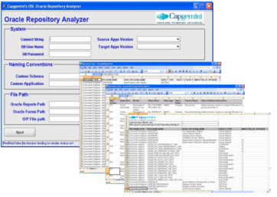
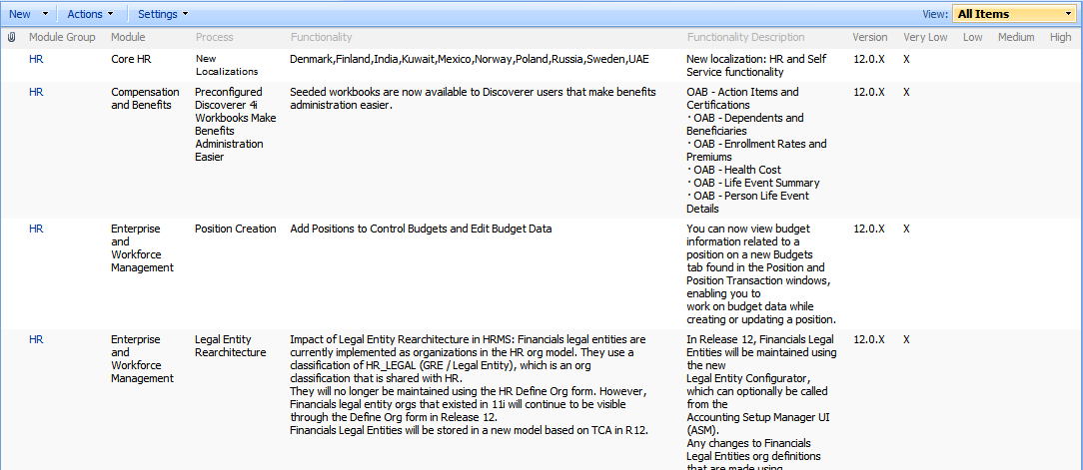
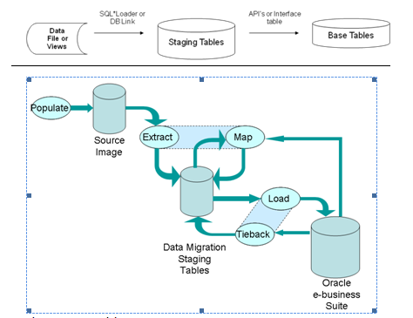
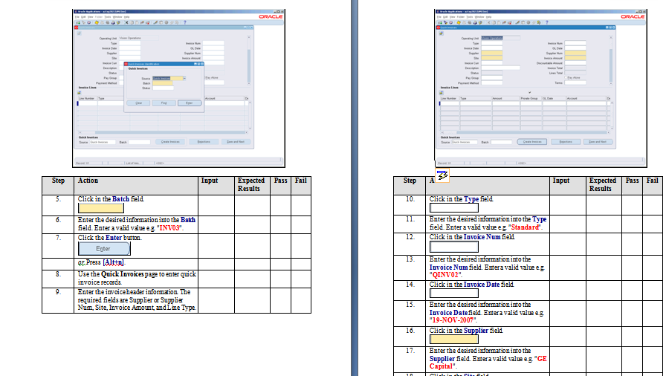
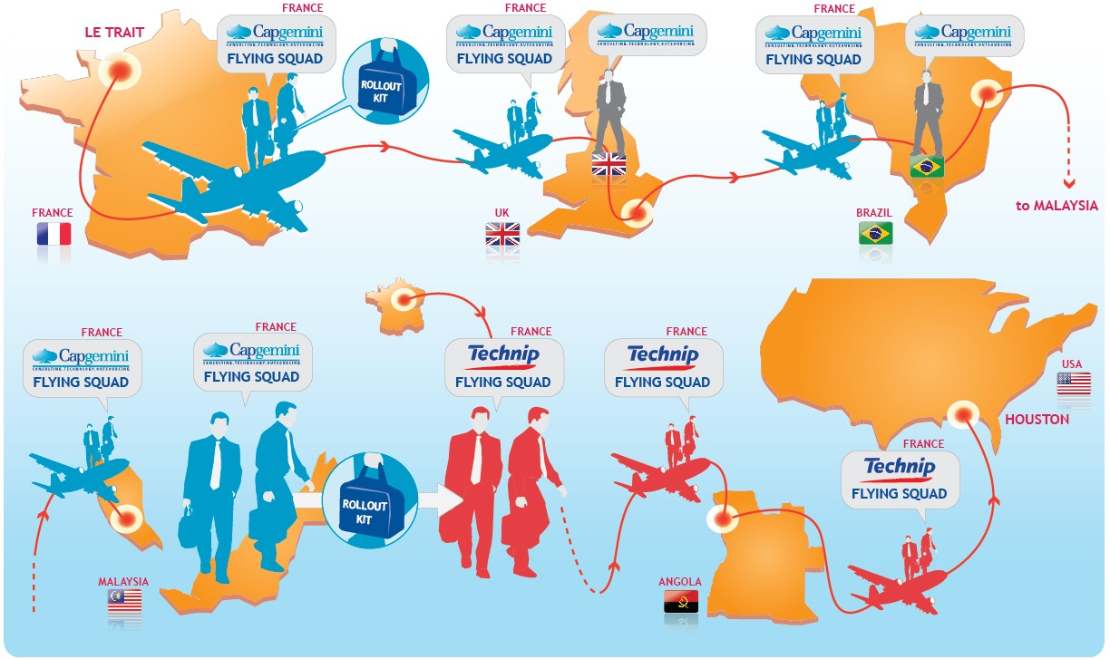
Capgemini proprietary tools & accelerators to increase productivity, predictability and reduce costs
Custom Spotlighter
Functional Impact Matrix
Data Migration Toolkit
Testing Toolkit
Country Localization Kit
Global Rollout Kit

Slide 19
Questions and Answers

